Slide 1

STUDY & IMPLEMENTATION OF PARALLEL WEB CRAWLER
Project Guide: Team Members: Ms. Priyanka Banerjee Vanshika Nigam (Department of Computer Science & Engg.) Shivangi Rai
Parul Ananya Ruchin Agarwal
(4TH YEAR PROJECT)

Slide 2
INTRODUCTION
What is a Web Crawler?
A Web Crawler is an Internet Bot that systematically browses the World Wide Web, typically for the purpose of Web Indexing.
Web Search Engines and some other sites use Web crawling or spidering software to update their web content or indexes of others sites' web content. Web crawlers can copy all the pages they visit for later processing by a search engine that indexes the downloaded pages so that users can search them much more quickly.

Slide 3
What is Web Crawling?
A Web crawler starts with a list of URLs to visit, called the seeds. As the crawler visits these URLs, it identifies all the hyperlinks in the page and adds them to the list of URLs to visit, called the crawl frontier. URLs from the frontier are recursively visited according to a set of policies.
The large volume implies that the crawler can only download a limited number of the Web pages within a given time, so it needs to prioritize its downloads. The high rate of change implies that the pages might have already been updated or even deleted.
The number of possible crawlable URLs being generated by server-side software has also made it difficult for web crawlers to avoid retrieving duplicate content. Endless combinations of HTTP GET(URL-based) parameters exist, of which only a small selection will actually return unique content.

Slide 4
Crawling Policy
The behaviour of a Web crawler is the outcome of a combination of policies:
a selection policy that states which pages to download,
a re-visit policy that states when to check for changes to the pages,
a politeness policy that states how to avoid overloading Web sites, and
a parallelization policy that states how to coordinate distributed web crawlers.

Slide 5
What Is a Parallel Crawler?
As the size of the web grows, it becomes more difficult to retrieve the whole or a significant portion of the web using a single process.
It becomes imperative to parallelize a crawling process, in order to finish downloading pages in a reasonable amount of time.
We refer to this type of crawler as a parallel crawler.
The main goal in designing a parallel crawler, is to maximize its performance (Download rate) & minimize the overhead from parallelization.

Slide 6
PHASE 1- REQUIREMENT ANALYSIS
This is the first phase of SDLC (Software Development Life Cycle).
In this phase the preliminary analysis of the software is done.
The nature , scope and objective of the problem is assessed.
The requirements of the problem are also analysed.

Slide 7
OBJECTIVE
To develop the parallel web Crawler for gathering information from the web by using user input.
To apply composing techniques that links similar types of information from the database and generates relevant query results.
To design a graphical user interface for users from where they can submit their queries for desired information.
To incorporate multi-threaded functionality within the crawler.
To design a fetcher that downloads the pages from web efficiently.

Slide 8
SCOPE
With the rapid increase in the number of websites entering the Web on a continuous basis, it is required to have an approach to store the links and pages and make them accessible by the Search Engines.
These various websites, their URLs, page links etc. comes under its domain.

Slide 9
Software Requirement for Development Time
Microsoft Windows XP/Vista/7 Operating System
NetBeans IDE 6.1 or higher
JDK 5.0 or higher
MySQL Server 5.0 or higher

Slide 10
Phase 2- Designing
In Designing stage of SDLC we describe the desired features and operations in detail, including screen layouts, process diagrams, pseudo code and other documentation.

Slide 11
Working of crawling process
A web crawler starts off by placing an initial set of URLs in a seed queue.
The web crawler gets a URL from the seed queue, downloads the web page, extracts any URLs in the downloaded page, puts the new URLs in the seed queue, and gets the next URL from the seed queue.
The web crawler repeats this crawling process until it decides to stop.

Slide 12
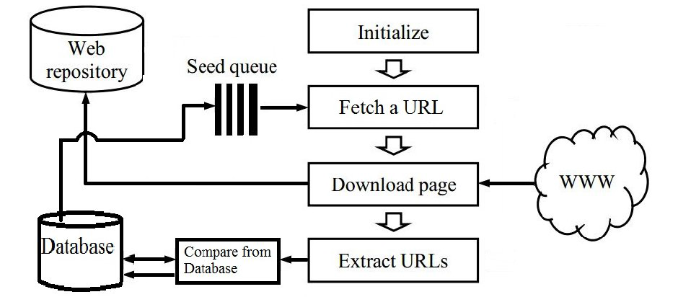
Figure 1: Flow of a crawling process.

Slide 13
Architecture of Parallel Crawler
A parallel crawler consists of multiple crawling processes: “c-proc”.
C-proc performs single-process crawler tasks:
Downloads pages from the web.
Stores downloaded pages locally.
Extracts URLs from downloaded pages and follows links.
Depending on how the c-proc’s split the download task, some of the extracted links may be sent to other c-proc’s.e

Slide 14
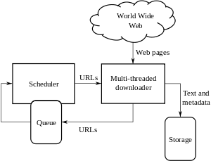
Architecture

Slide 15
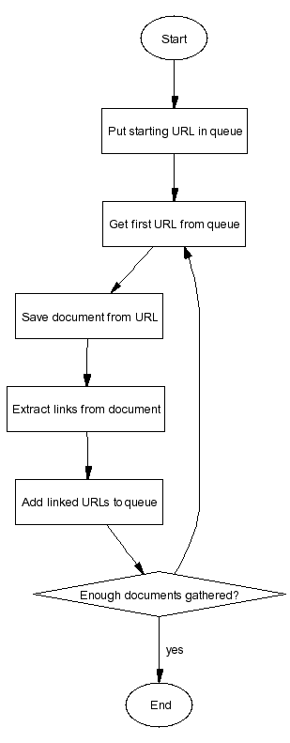
Flow Diagram

Slide 16
Algorithm
Crawler ()
Begin
While (URL set is not empty)
Begin
Take a URL from the set of seed URLs;
Determine the IP address for the host name;
Determine the protocol of underlying host like http, ftp, gopher etc.;
Based on the protocol of the host, download the document;
Identify the document format like doc, html, or pdf etc.

Slide 17
Check whether the document has already been downloaded or not;
If the document is fresh one
Then
Read it and extract the links or references to the other sites from that documents;
Else
Continue;
Convert the URL links into their absolute URL equivalents;
Add the URLs to set of seed URLs;
End;
End.

Slide 18
PHASE 3: IMPLEMENTATION(CODING)

Slide 19
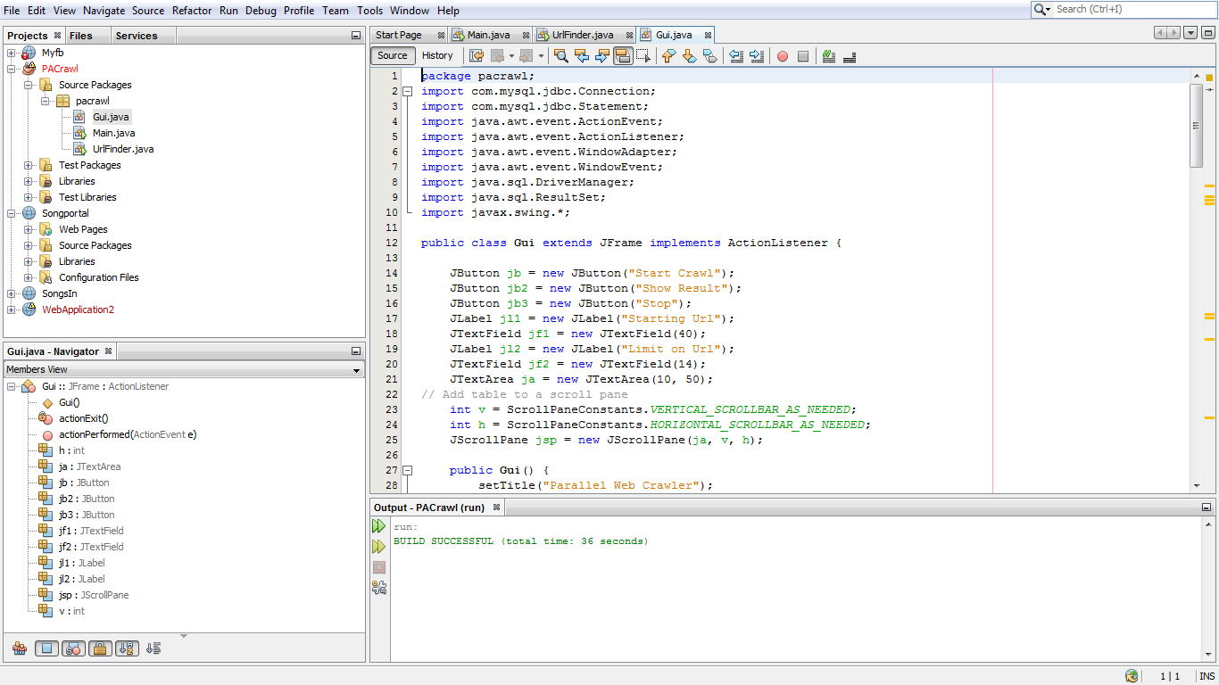

Slide 20
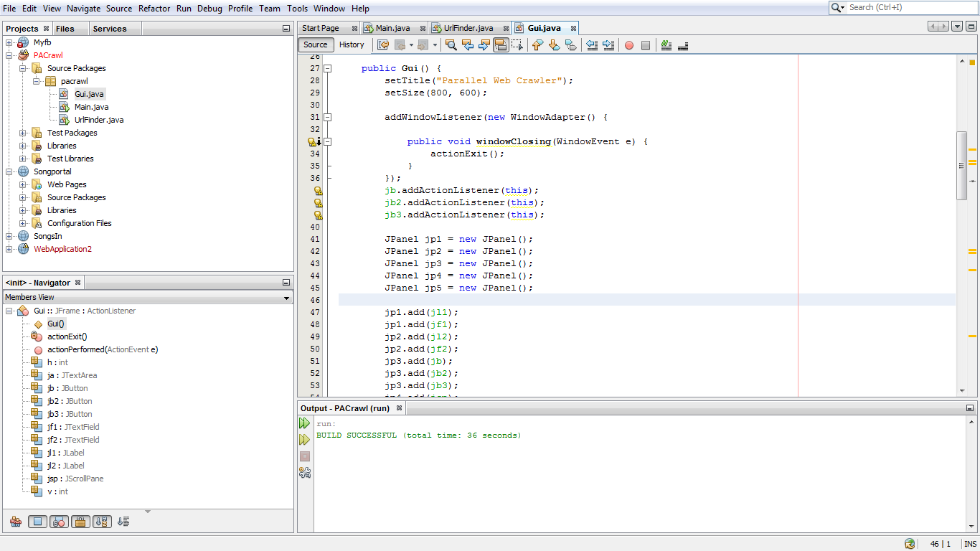

Slide 21
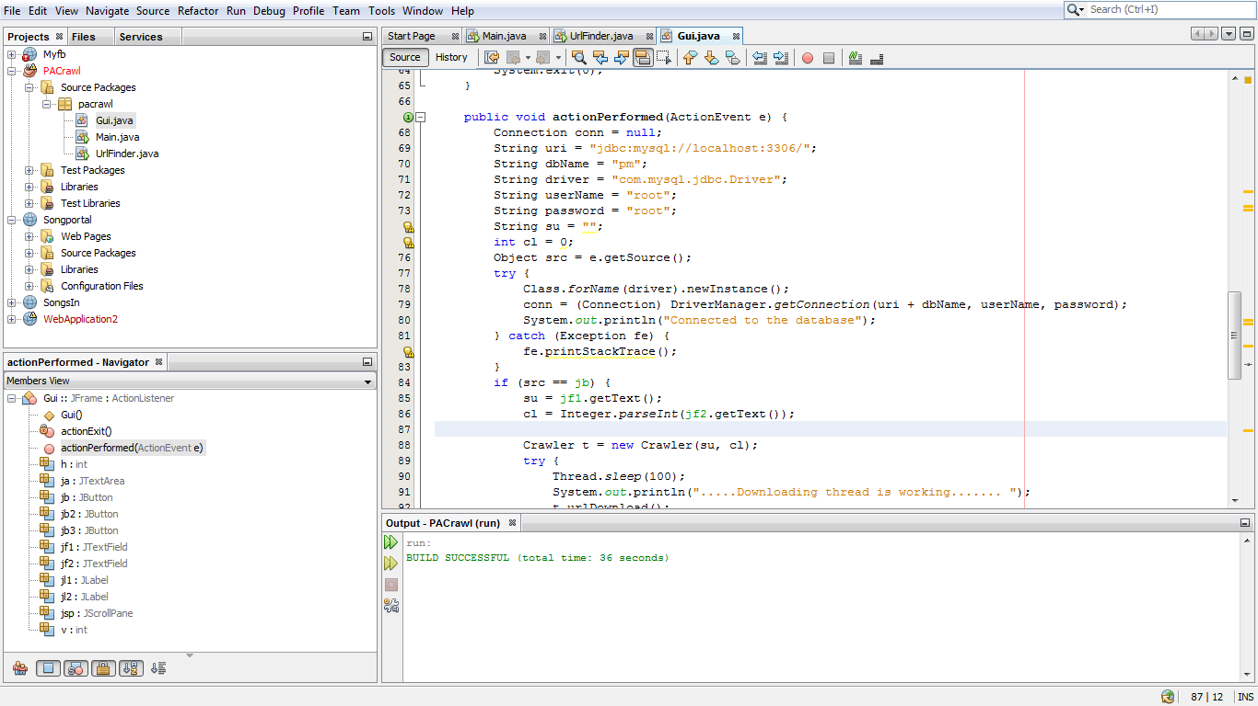

Slide 22
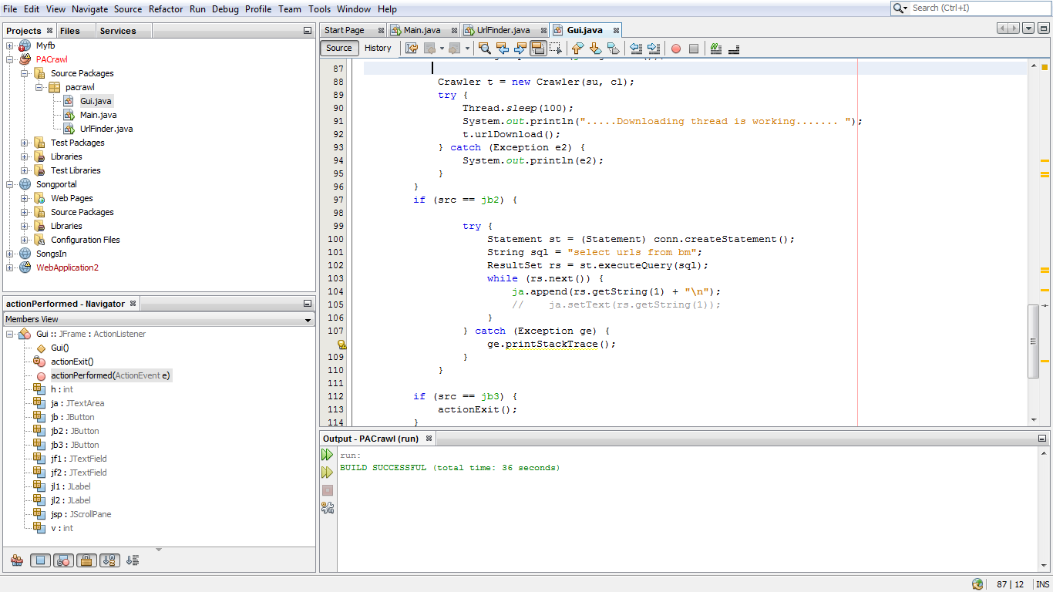

Slide 23
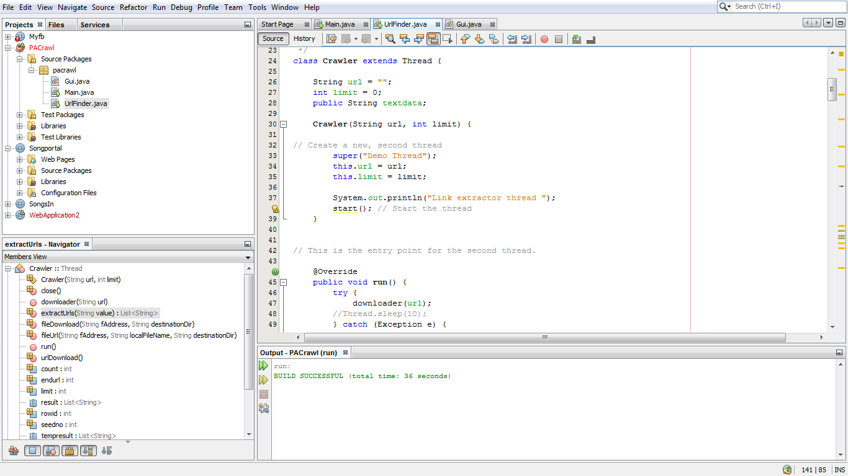

Slide 24
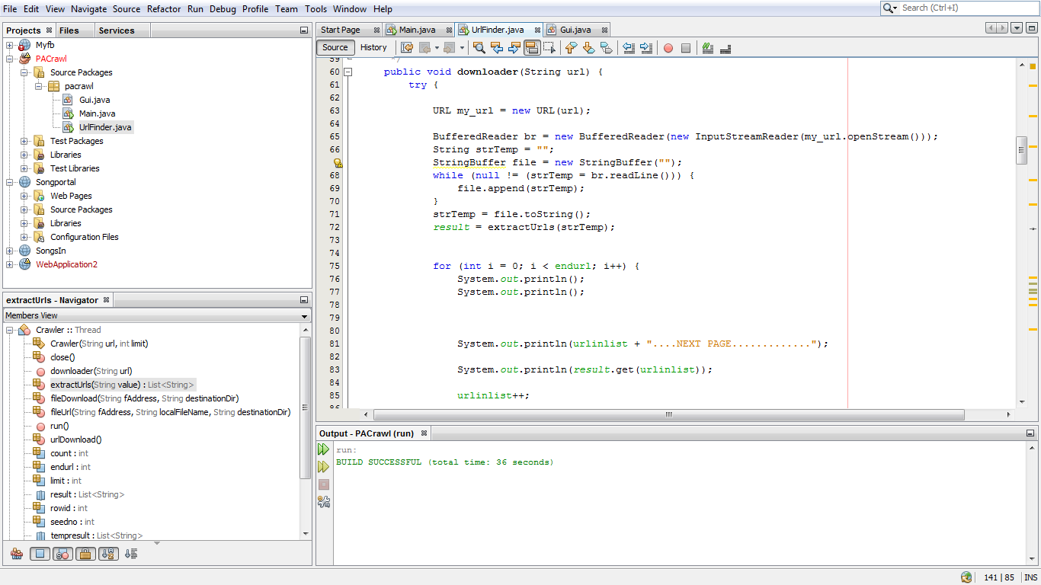

Slide 25
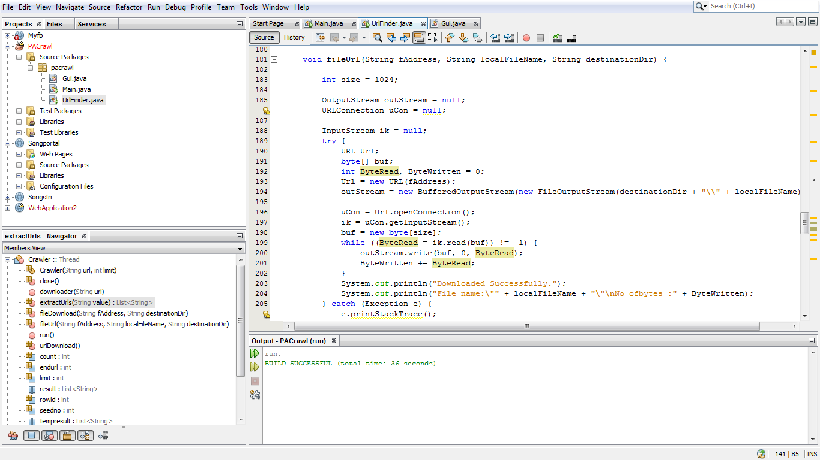

Slide 26
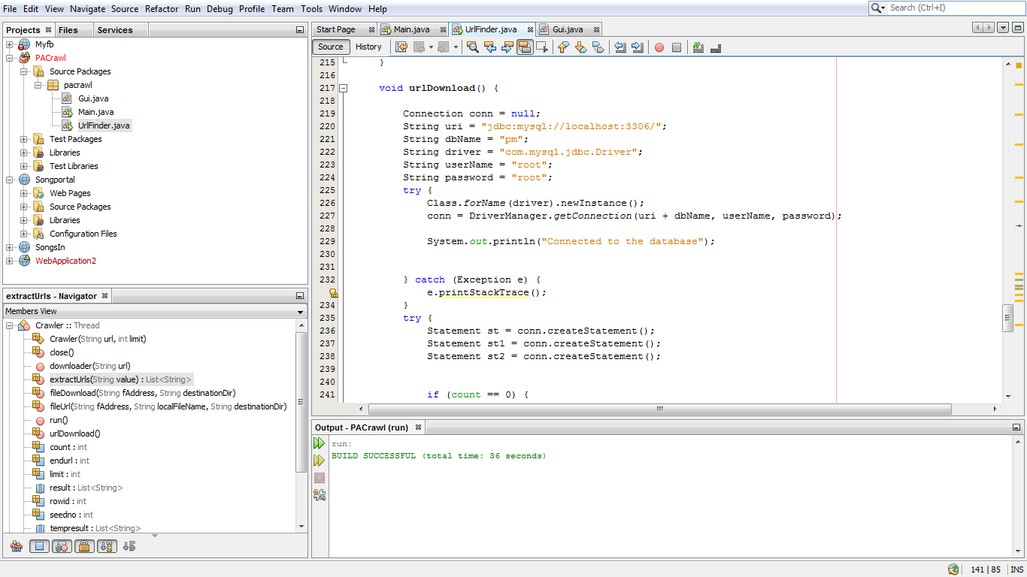

Slide 27
PHASE-4 TESTING
This phase aims at bringing all the pieces together into a special testing environment , then checks for errors , bugs and interoperability.
For testing purpose we run the crawler again and again, fetch the URLs and download the related URLs and pages.
We check whether the fetched URLs and pages are getting stored in the database or not.
We successfully test our software and hence ensure the proper functioning of our window application.

Slide 28
Issues and Challenges
Since size and change rate of the Web is very high, hence, the crawler needs to address many important challenges, including the following:
Overlap: download the same page multiple times.
Need to coordinate between the processes to minimize overlap.
To save network bandwidth and increase the crawler’s effectiveness.

Slide 29
Quality: download “important” pages first.
To maximize the “quality” of the downloaded collection.
Each process may not be aware of whole web image, and make a poor crawling decision based on its own image of the web.
Make sure that the quality of downloaded pages is as good for a parallel crawler as for a centralized.
Communication bandwidth: to prevent overlap and improve quality,
Need to periodically communicate to coordinate.
Communication grows significantly as number of crawling processes increases.
Need to minimize communication overhead while maintaining effectiveness of crawler.

Slide 30
Solutions to Challenges and Issues
Scalability: As the number of crawler nodes increases, the throughput of the crawlers should grow . The throughput can be maximized by two techniques.
Load on crawler nodes must be balanced so that they are not idle.
Reducing the communication while executing the crawl.

Slide 31
Network-load dispersion:
Multiple crawling processes of a parallel crawler may run at geographically distant locations, each downloading “geographically-adjacent” pages.
We can disperse the network load to multiple regions.
Might be necessary when a single network cannot handle the heavy load from a large-scale crawl.
A parallel crawler may actually reduce the network load.
If a crawling process in Europe collects all European pages, and another in North America crawls all North American pages, the overall network load will be reduced, because pages go through only “local” networks.

Slide 32
PHASE 5- MAINTAINENCE
During the maintenance stage of SDLC, the system is assessed to ensure it doesn’t become obsolete.
It involves continuous evaluation of the system in terms of its performance.
This phase is carried out when the software has been developed completely.
Our main aim is to improve the quality of the crawler by-
reducing redundancy
increasing the speed and the crawling capacity of the crawler

Slide 33
Application of Parallel Web Crawler
Crawler Based Search Engine
Example : Google – www.google.co.in
www.google.com
Websites- Search Boxes in Websites
www.facebook.com

Slide 34
FUTURE SCOPE
Search is the most important tool in the present world but the scope of the searching has largely increased now.
The web not only contains the surface data but also the hidden data therefore using a simple search engine will not solve the problem.
We require a crawler that can produce information from the web.

Slide 35
FEASIBILITY
It is an approach which can be used to have an easy and spontaneous access to the page links of various websites present in the market.

Slide 36
CONCLUSION
A web crawler is a way for search engines and other users to regularly ensure that their databases are up to date.
Web crawlers are a central part of the search engines and details on the algorithms and architecture are kept as business secrets.
In concerns of Search Engine Spamming which prevent search engines from publishing their ranking algorithms.

